Slide 1
Enterprise Architecture
Week 2: January 26, 2018
Professor: Steve Conrad

Slide 2
Top Industry Frameworks
The Zachman Framework for Enterprise Architectures
  Although self-described as a framework, is actually more accurately defined as a taxonomy
The Open Group Architectural Framework (TOGAF)
  Although called a framework, is actually more accurately defined as a process
The Federal Enterprise Architecture
  Can be viewed as either an implemented enterprise architecture or a proscriptive methodology for creating an enterprise architecture
The Gartner Methodology
  Can be best described as an enterprise architectural practice
Source: Comparison of the Top Four Enterprise Architecture Methodologies

Slide 3
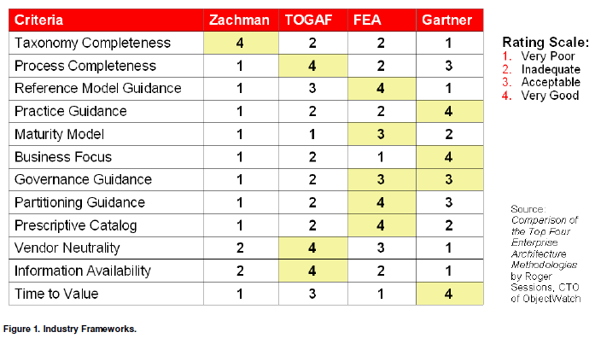
Industry Framework Comparisons
Source: The Oracle Enterprise Architecture Framework October 2009

Slide 4
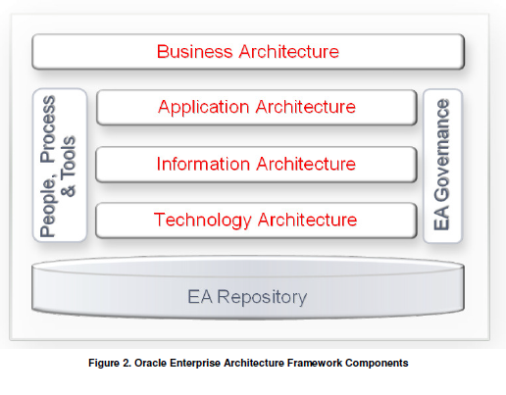
Oracle Enterprise Architecture Framework Components
Source: The Oracle Enterprise Architecture Framework October 2009

Slide 5
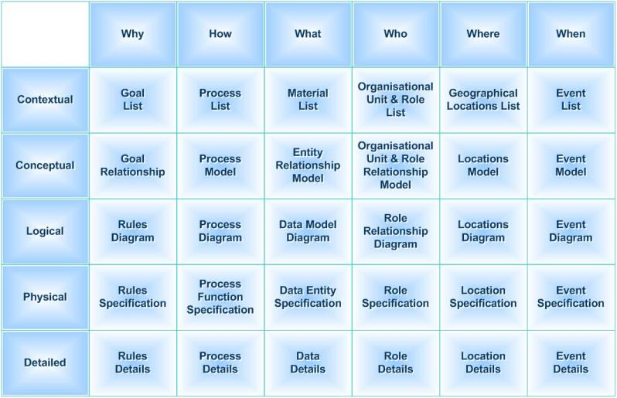
IBM Cognos BI Architecture – Details
Source: By Ideasintegration(image) + SunSw0rd(text) - Own work, CC BY-SA 3.0, https://commons.wikimedia.org/w/index.php?curid=20113287

